Slide 1








Group presentation
Project-2
Credit risk dataset
Ulugbek Islomov
Maurice Goode
Soumae Patidar

Slide 2

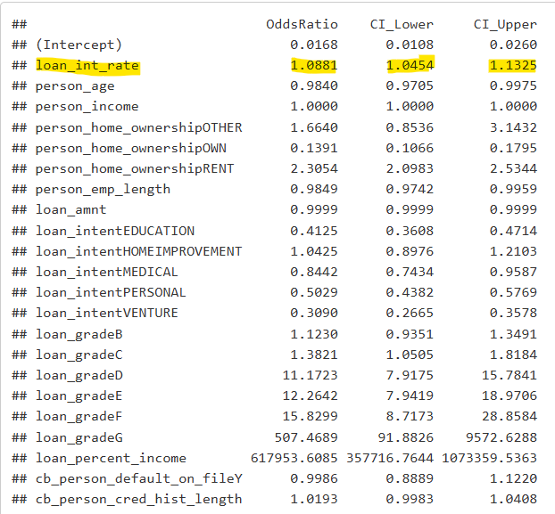
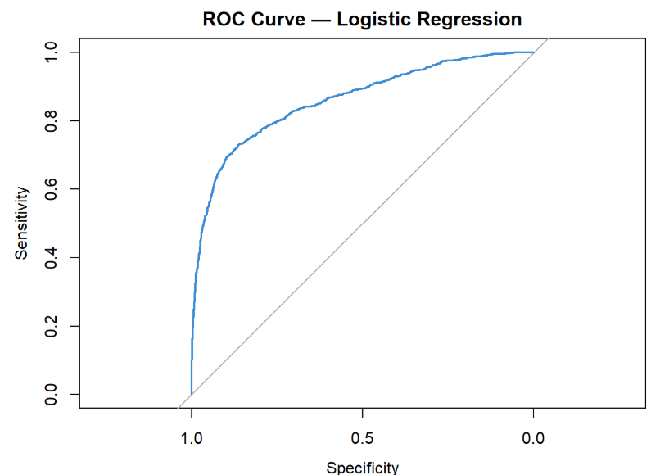
Does interest rate influence the probability of loan default, even after controlling for borrower and loan characteristics?
SMQ-3
Logistic Regression Metrics:
P-Value of Interest Rate: Below 0.05. Unlikely the observed relationship occurred by random chance in the data
Odds Ratio of Interest Rate: A one-unit increase in interest rate increases the odds of default by 1.0881, holding all else constant
McFadden R² : The R-Squared value = 0.3632. 36.32% of the model is explained by the training set
AUC = 85.93%. This is an excellent/good performance

Slide 3
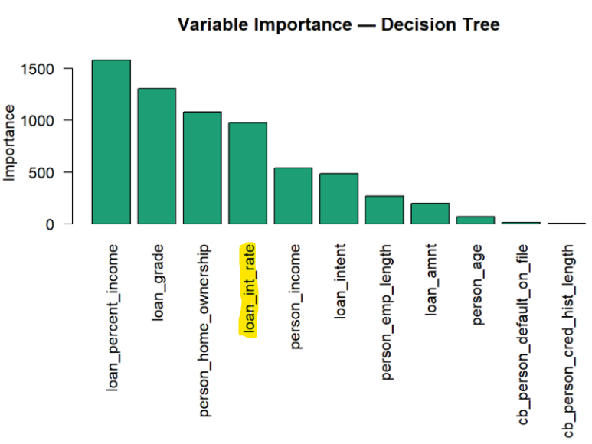
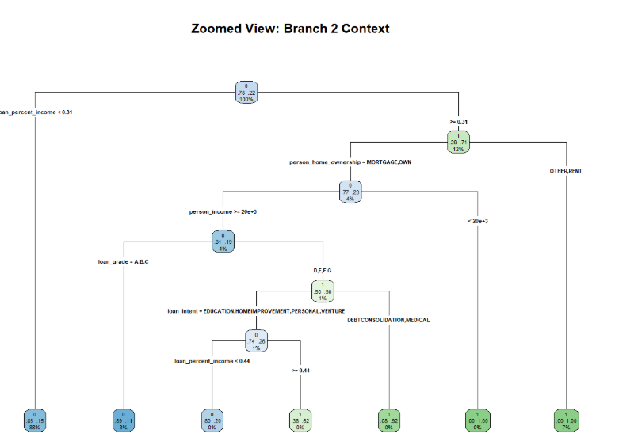
Classification Tree
SMQ-3
Decision Tree Metrics:
Variable Importance: loan_int_rate is the 4th most important
Optimal Complexity Parameter = 0.000540. The model is relatively complex
Sensitivity = 70.57%. Higher than the logistic regression model
Specificity = 99.55%. Very high, could be because it is a single decision tree
AUC = 90.32%. This is an outstanding/perfect performance

Slide 4
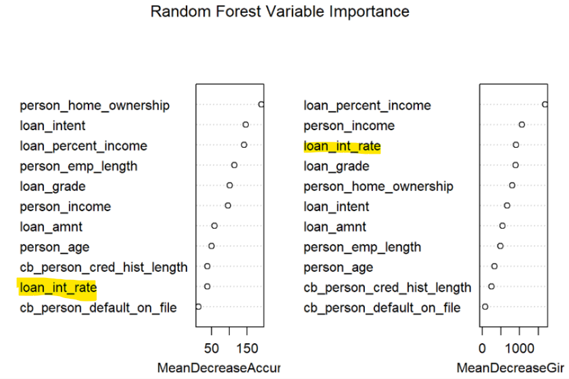
Random Forest
SMQ-3
Random Forest Metrics:
Mean Decrease Accuracy: Even though interest rate is used to make splits, the model can still predict the outcome almost as well without it
Mean Decrease Gini: Interest rate is frequently used for splits across many trees
Summary: loan_int_rate might have a relationship to other variables

Slide 5
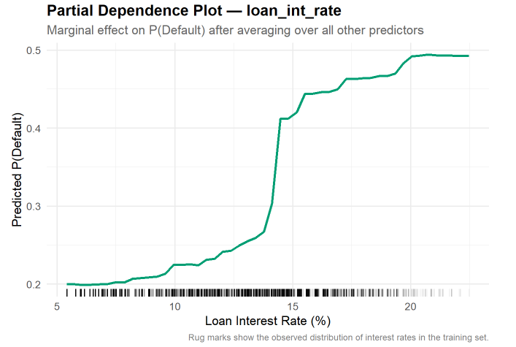
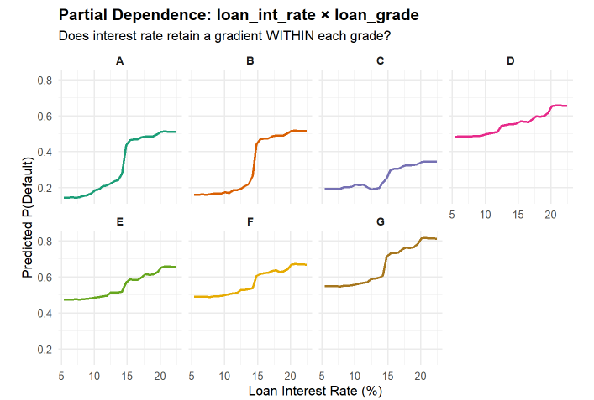
Random Forest Cont.
SMQ-3
Random Forest Metrics:
Plot 1: Interest rate has an upward slope; it has real predictive power even after controlling the other variables
Plot 2: The gradient for each loan grade gets flatter. Loan grade is absorbing interest rate’s influence on the model.

Slide 6
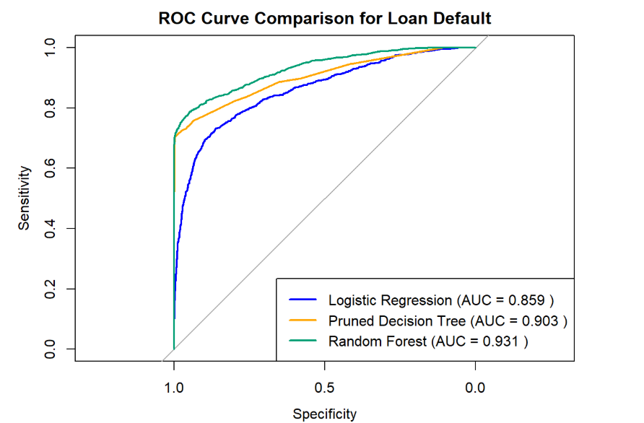
SMQ-3
Smart Question 3 Summary
Conclusion:
Yes, interest rate influences the probability of default.
Other important variables: loan_percentage_income, cb_person_default_on_file, cb_credit_hist_length, loan_grade
Model Bias: The data is imbalanced. 78% of the data are non-default borrowers.

Slide 7
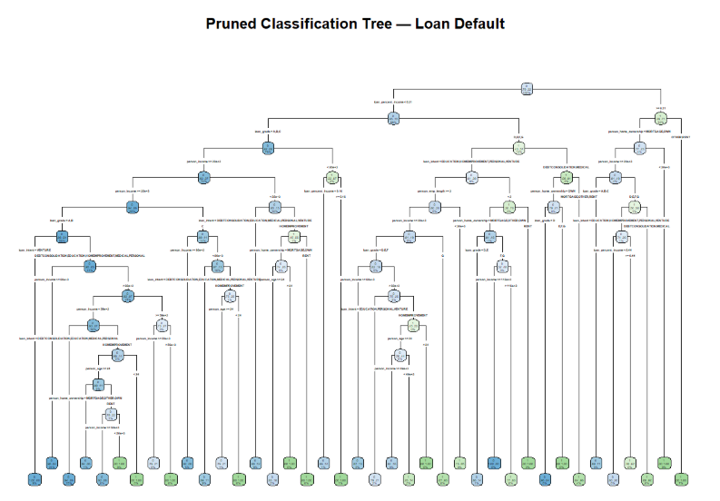
Appendix

